Slide 1

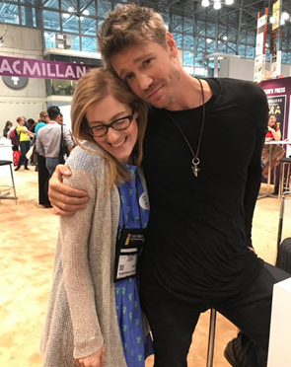
Booth #2816
we blog, we tweet,
we e-newsletter,
we pose with Chad Michael Murray,
WE’RE JUST LIKE YOU!

Slide 2

read our blog: www.macmillanlibrary.com
subscribe to our monthly e-newsletter: bit.ly/MacLibraryNews
follow us on twitter: @MacmillanLib
e-mail us: talia.sherer@macmillan.com
anne.spieth@macmillan.com
emily.day@macmillan.com

Slide 3
Get Whitelisted on Edelweiss for Macmillan E-Galleys!
Register for Edelweiss with your professional e-mail address.
Send Anne a message (anne.spieth@macmillan.com; subject line: Edelweiss) that includes the e-mail address you registered with, your full name and your current library.
Anne will send you a confirmation email once you’ve been whitelisted (the process can take from 2-4 weeks but we promise it’s worth it).
Download to your heart’s delight whenever you see the green DRC button!
It’s that easy!

Slide 4


Remember to nominate titles for LibraryReads!
LibraryReads is a program that harnesses the value of “staff library picks” into a single nation-wide discovery tool, a monthly list of ten newly released must-reads.
2018 Nomination Deadlines
Librarians must nominate their favorite titles according to the deadlines below. For example, your reviews for books with June 2018 on sale dates must be submitted via Edelweiss by Apr. 20th to be considered for the June 2018 list.
LIST NOMS DUE DATE
June 2018 List April 20, 2018
July 2018 List May 20, 2018
Aug. 2018 List June 20, 2018
Sept. 2018 List July 20, 2018
Oct. 2018 List Aug. 20, 2018
Nov. 2018 List Sept. 20, 2018
Any Public Library Staff Member Can Nominate Books via
&
Have questions or want marketing materials and other resources? Visit http://libraryreads.org/ or read our FAQ at http://bit.ly/MacLibraryReads.

Slide 5




Macmillan Library Adult Events @ TxLA
Kirkus Reviews
Booklist
“Authors for Your Book Club” Panel with Katherine Center
TODAY @ 2:45 PM
Room C156
FREE
“Evening With the Authors” Dinner
featuring John Hart & Bryan Mealer
TODAY @ 6:00 PM
Dallas Public Library
Tickets required

Slide 6




Bestsellers
Booklist
Library Journal
THE HIGH TIDE CLUB
Mary Kay Andrews
May 8, 2018
9781250126061
Hardcover | $27.99 Fiction / Contemporary Women
300,000
SHELTER IN PLACE
Nora Roberts
May 29, 2018
9781250161598
Hardcover | $27.99
Fiction / Contemporary Women
1,000,000
HOW HARD CAN IT BE?
Allison Pearson
June 5, 2018
9781250086082
Hardcover | $27.99
Fiction / Humorous
250,000
BRING ME BACK
B. A. Paris
June 19, 2018
9781250151339
Hardcover| $26.99 Fiction / Thrillers / Psychological
400,000

Slide 7




Book Club Picks
MY EX-LIFE
Stephen McCauley
May 8, 2018
9781250122438
Hardcover| $25.99
Fiction / Literary
100,000
THE LOST FOR WORDS BOOKSHOP
Stephanie Butland
June 19, 2018
9781250124531
Hardcover | $26.99
Fiction / Contemporary Women
60,000
BEFORE AND AGAIN
Barbara Delinsky
June 26, 2018
9781250119490
Hardcover| $27.99
Fiction / Contemporary Women
250,000
THE MERE WIFE
Maria Dahvana Headley
July 17, 2018
9780374208431
Hardcover| $27.00
Fiction / Literary
25,000

Slide 8




Diverse Debuts
Publishers Weekly
SONG OF BLOOD & STONE
L. Penelope
May 1, 2018
9781250148070
Hardcover | $26.99
Fiction / Fantasy / Historical
50,000
NUMBER ONE CHINESE RESTAURANT
Lillian Li
June 19, 2018
9781250141293
Hardcover | $27.00
Fiction / Literary
40,000
IF YOU SEE ME, DON’T SAY HI: Stories
Neel Patel
July 10, 2018
9781250183194
Hardcover | $24.99
Fiction / Short Stories
30,000
SEVERANCE
Ling Ma
August 14, 2018
9780374261597
Hardcover | $26.00
Fiction / Literary
20,000

Slide 9




Nonfiction
MINORITY LEADER: How to Lead from the Outside and Make Real Change
Stacey Abrams
April 24, 2018
9781250191298
Hardcover | $28.00
Self-Help / Motivational & Inspirational
75,000
A HIGHER LOYALTY: Truth, Lies, and Leadership
James Comey
April 17, 2018
9781250192455
Hardcover | $29.99
Biography & Autobiography / Political
350,000
I SEE LIFE THROUGH ROSÉ-COLORED GLASSES: True Stories and Confessions
Lisa Scottoline & Francesca Serritella
July 10, 2018
9781250163059
Hardcover | $24.99
Family & Relationships / Parenting / Parent & Adult Child
75,000
CITY OF DEVILS: The Two Men Who Ruled the Underworld of Old Shanghai
Paul French
July 3, 2018
9781250170583
Hardcover | $28.00
History / Asia / China
75,000

Slide 10
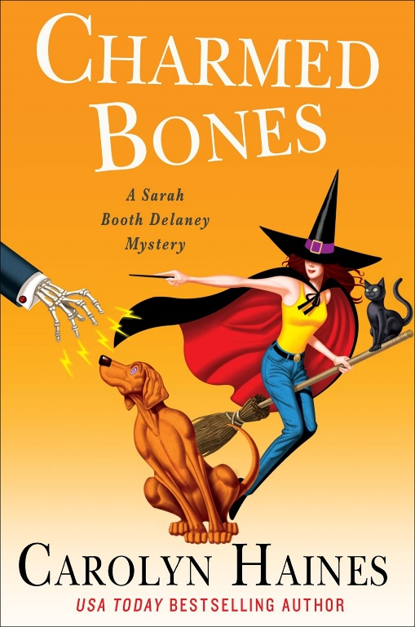


Watching the Detectives
CHARMED BONES
Carolyn Haines
May 15, 2018
9781250154132
Hardcover | $26.99
Fiction / Mystery & Detective / Cozy
35,000
BROKEN ICE
Matt Goldman
June 12, 2018
9780765391315
Hardcover | $25.99
Fiction / Mystery & Detective / Private Investigators
50,000
A GATHERING OF SECRETS
Linda Castillo
July 10, 2018
9781250121318
Hardcover | $26.99
Fiction / Mystery & Detective / Police Procedural
150,000

Slide 11



Thrillers
Library Journal
Library Journal
JAR OF HEARTS
Jennifer Hillier
June 12, 2018
9781250154194
Hardcover | $26.99
Fiction / Thrillers / Crime
75,000
BABY TEETH
Zoje Stage
July 17, 2018
9781250170750
Hardcover | $26.99
Fiction / Thrillers / Psychological
100,000
THE OTHER WOMAN
Sandie Jones
August 21, 2018
9781250191984
Hardcover | $26.99
Fiction / Thrillers / Psychological
200,000

Slide 12

THANK YOU!

