Slide 1

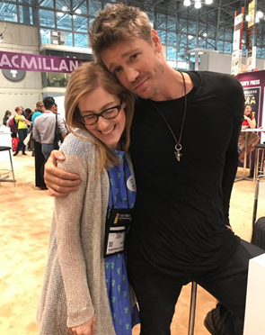
Booth #1741
we blog, we tweet,
we e-newsletter,
we pose with Chad Michael Murray,
WE’RE JUST LIKE YOU!

Slide 2

read our blog: www.macmillanlibrary.com
subscribe to our monthly e-newsletter: bit.ly/MacLibraryNews
follow us on twitter: @MacmillanLib
e-mail us: talia.sherer@macmillan.com
anne.spieth@macmillan.com
emily.day@macmillan.com

Slide 3
Get Whitelisted on Edelweiss for Macmillan E-Galleys!
Register for Edelweiss with your professional e-mail address.
Send Anne a message (anne.spieth@macmillan.com; subject line: Edelweiss) that includes the e-mail address you registered with, your full name and your current library.
Anne will send you a confirmation email once you’ve been whitelisted (the process can take from 2-4 weeks but we promise it’s worth it).
Download to your heart’s delight whenever you see the green DRC button!
It’s that easy!

Slide 4


Remember to nominate titles for LibraryReads!
LibraryReads is a program that harnesses the value of “staff library picks” into a single nation-wide discovery tool, a monthly list of ten newly released must-reads.
2018 Nomination Deadlines
Librarians must nominate their favorite titles according to the deadlines below. For example, your reviews for books with Apr. 2018 on sale dates must be submitted via Edelweiss by Feb. 20th to be considered for the Apr. 2018 list.
LIST NOMS DUE DATE
April 2018 List Feb. 20, 2018
May 2018 List March 20, 2018
June 2018 List April 20, 2018
July 2018 List May 20, 2018
Aug. 2018 List June 20, 2018
Sept. 2018 List July 20, 2018
Oct. 2018 List Aug. 20, 2018
Nov. 2018 List Sept. 20, 2018
Any Public Library Staff Member Can Nominate Books via
&
Have questions or want marketing materials and other resources? Visit http://libraryreads.org/ or read our FAQ at http://bit.ly/MacLibraryReads.

Slide 5

Macmillan Library @ ALA MW
AAP / LibraryReads
“Book Talk” Breakfast
with Sandra Dallas
Monday @ 8:30 AM
Room # 605-607
FREE

Slide 6




Bestsellers
AFTER ANNA
Lisa Scottoline
April 10, 2018
9781250099655
Hardcover | $27.99
Fiction / Thrillers / Suspense
400,000
BRING ME BACK
B. A. Paris
June 19, 2018
9781250151339
Hardcover| $26.99 Fiction / Thrillers / Psychological
400,000
HOW HARD CAN IT BE?
Allison Pearson
June 5, 2018
9781250086082
Hardcover | $27.99
Fiction / Humorous
250,000
SHELTER IN PLACE
Nora Roberts
May 29, 2018
9781250161598
Hardcover | $27.99
Contemporary Women
1,000,000

Slide 7

Author Spotlight
HOW TO WALK AWAY
Katherine Center
May 15, 2018
9781250149060
Hardcover | $26.99
Fiction / Contemporary Women
100,000

Slide 8




Nonfiction
LOOK ALIVE OUT THERE:
Essays
Sloane Crosley
April 3, 2018
9780374279844
Hardcover | $26.00
Literary Collections / Essays
75,000
MINORITY LEADER: How to Lead from the Outside and Make Real Change
Stacey Abrams
April 24, 2018
9781250191298
Hardcover | $27.00
Self-Help / Motivational & Inspirational
75,000
THE ELECTRIC WOMAN: A Memoir in Death-Defying Acts
Tessa Fontaine
May 1, 2018
9780374158378
Hardcover | $27.00
Biography & Autobiography / Personal Memoirs
75,000
A HIGHER LOYALTY: Truth, Lies, and Leadership
James Comey
May 1, 2018
9781250192455
Hardcover | $32.99
Biography & Autobiography / Political
350,000

Slide 9





Lit Fic
GIRLS BURN BRIGHTER
Shobha Rao
March 6, 2018
9781250074256
Hardcover | $25.99
Fiction / Literary
50,000
LET’S NO ONE GET HURT
Jon Pineda
March 20, 2018
9780374185244
Hardcover | $25.00
Fiction / Literary
15,000
RUST & STARDUST
T. Greenwood
August 7, 2018
9781250164193
Hardcover | $26.99
Fiction / Literary
75,000
THE PARKING LOT ATTENDANT
Nafkote Tamirat
March 13, 2018
9781250128508
Hardcover | $25.00
Fiction / Literary
30,000
TREEBORNE
Caleb Johnson
June 5, 2018
9781250169082
Hardcover | $26.00 Fiction / Literary
35,000

Slide 10

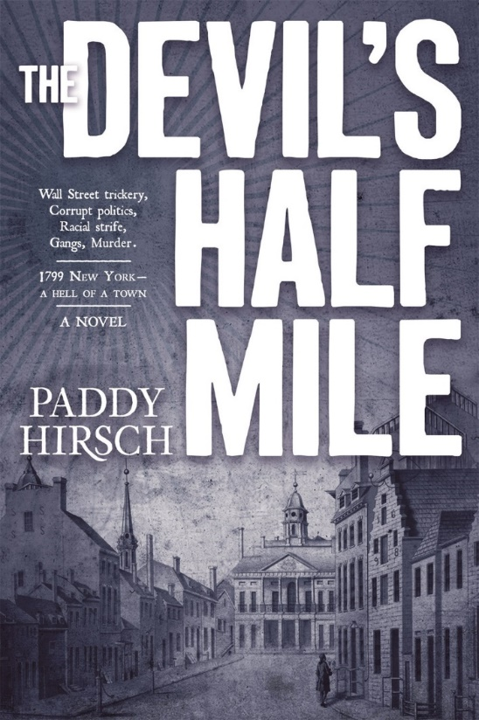
Historical Fiction
THE ITALIAN PARTY
Christina Lynch
March 27, 2018
9781250147837
Hardcover | $25.99
Fiction / Literary
50,000
THE DEVIL'S HALF MILE
Paddy Hirsch
June 5, 2018
9780765399137
Hardcover | $24.99
Fiction / Thrillers / Historical
100,000

Slide 11



Debuts
OUR KIND OF CRUELTY
Araminta Hall
May 8, 2018
9780374228194
Hardcover| $26.00
Fiction / Thrillers / Psychological
200,000
THE COINCIDENCE MAKERS
Yoav Blum
March 6, 2018
9781250146113
Hardcover | $26.99
Fiction / Literary
50,000
INDECENT
Corinne Sullivan
March 6, 2018
9781250147073
Hardcover | $24.99
Fiction / Coming Of Age
50,000

Slide 12



Watching the Detectives
BROKEN ICE
Matt Goldman
June 12, 2018
9780765391315
Hardcover | $25.99
Fiction / Mystery & Detective / Private Investigators
50,000
CAGED
Ellison Cooper
July 10, 2018
9781250173836
Hardcover | $25.99
Fiction / Thrillers / Suspense
40,000
THE WOMAN IN THE WATER
Charles Finch
February 20, 2018
9781250139467
Hardcover | $25.99
Fiction / Mystery & Detective / Traditional
75,000

Slide 13



Thrillers
CRIMSON LAKE
Candice Fox
March 6, 2018
9780765398482
Hardcover | $25.99
Fiction / Thrillers / Crime
100,000
JAR OF HEARTS
Jennifer Hillier
June 12, 2018
9781250154194
Hardcover | $25.99 Fiction / Thrillers / Crime
75,000
SOMETIMES I LIE
Alice Feeney
March 13, 2018
9781250144843
Hardcover | $26.99
Fiction / Thrillers / Psychological
200,000

Slide 14

YA
SKY IN THE DEEP
Adrienne Young
April 24, 2018
9781250168450
Hardcover | $17.99
Young Adult Fiction / Fantasy / Epic
Ages 12 to 18
100,000

Slide 15

THANK YOU!

